Slide 1
Stock Market Prediction System
Gaurav Sharma
18103050

Slide 2
Introduction
System aims to provide prediction of the stock the user wants to possibly invest in or just want to enquire about (system fetches data with the help of 3 different APIs).
System is able to display that particular prediction on a systematic graph and is able predict future low, high points.
It is able to Store this analysis onto a database to reduce future computations related to that particular stock and also utilizing that prior analysis to improve future predictions.
System also includes a separate additional feature for user to inculcate his/her intuition into the prediction and possibly improving the accuracy based on that.

Slide 3
The initial conception of the idea for the system originally started for me after we discussed a case-study in our class; a system analyst developed a new system for an MNC to invest in stocks and bonds, and investment managers were responsible for this task.
They were not involved in the development of the system which caused an operation feasibility in this whole process, this made the investment managers a little hesitant to use the system because the system was just suggesting on the basis of mathematical computation and pattern analysis whereas the investors were accustomed to their usual pattern of thinking and analysis based upon their intuition and experience, one of the permissible answer to this problem can be to put this system into parallel conversion to show the benefits to the investors, but this is still not able to remove the awkwardness they face while using the system.

Slide 4
Features
Fetching, Storing and Maintaining Data of the Entered Stock.
Predicting the Stock’s Trajectory.
Option to include Intuition into the prediction.
Accuracy of the model.
Storing the Predicted Result for user to use.
Interactive Predicted Graph and Moving Average Curve.
Graphical user Interface for the user to interact with.

Slide 5
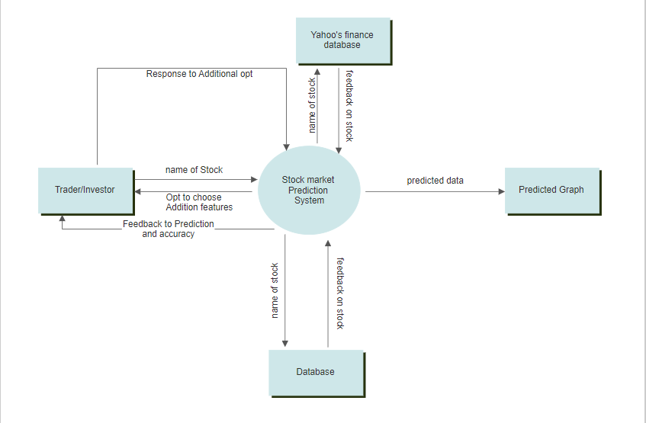
ZERO LEVEL DIAGRAM

Slide 6
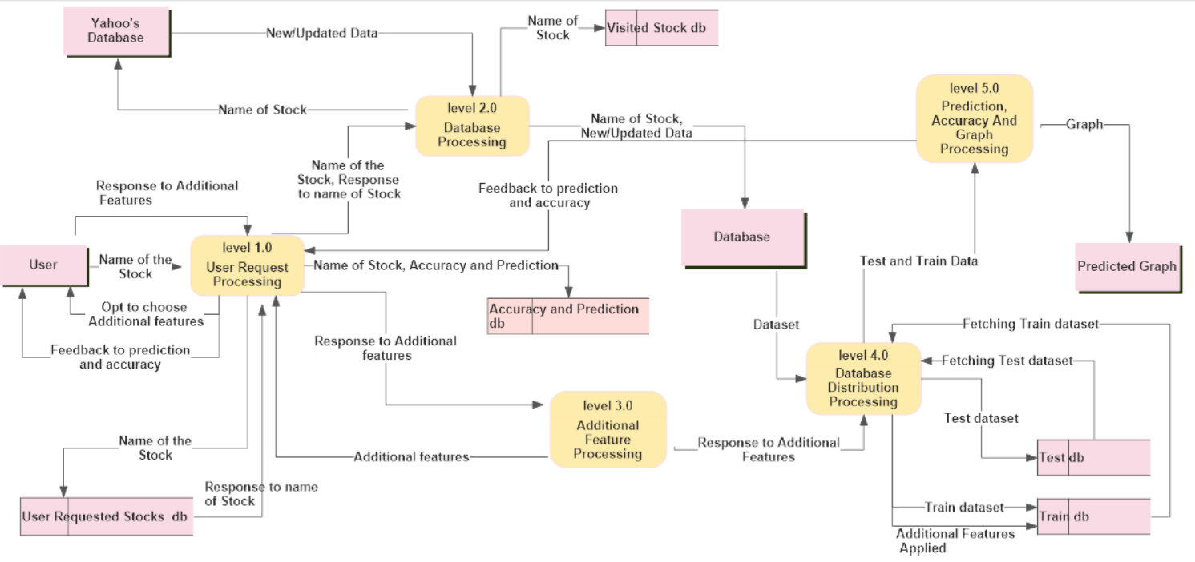
FIRST LEVEL DFD

Slide 7
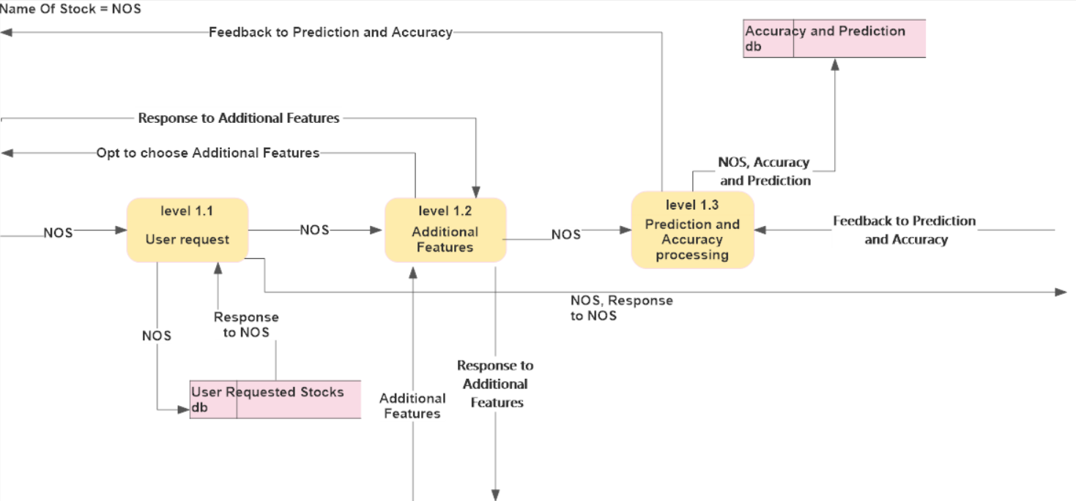
Level 1.1 Detailed

Slide 8
First Level Process Description: - Description of inbound and outbound data flows and the functionality of each Level.
PROCESS NAME: | Level 1.0 User Request Processing
DESCRIPTION: | This level process user’s Request, offers the user to use additional features and provide feedback to prediction and accuracy of the mentioned stock whilst maintain all the records and databases.
INBOUND DATA FLOWS | Name of the stock, Response to Additional Features, Feedback to prediction and accuracy, Response to name of stock, Additional features.
OUTBOUND DATA FLOWS: | Opt to choose Additional features, Feedback to prediction and accuracy, name of the stock. Response to Additional Features , (Name of stock, Accuracy and Prediction).
PROCESS NAME: | Level 2.0 Database Processing
DESCRIPTION: | This level after checking if the stock is already present in the system or not requests Yahoo’s database to provide the Historical Data of the stock mentioned, even if it’s in the system it will still check whether it’s up to data or not.
INBOUND DATA FLOWS | Name of the stock, Response to name of stock. New/Updated Data
OUTBOUND DATA FLOWS: | Name of the stock, (Name of the Stock, New/updated Data), Name of the stock.

Slide 9
PROCESS NAME: | Level 3.0 Additional Feature Processing
DESCRIPTION: | This level supplies the user with additional features to act on the dataset of the stock mentioned and forwarding the response of that exchange to the other levels of the system.
INBOUND DATA FLOWS | Response to Additional features
OUTBOUND DATA FLOWS: | Additional Features, Response to Additional Features.
PROCESS NAME: | Level 4.0 Database Distribution Processing
DESCRIPTION: | This level is responsible for splicing the dataset into Test and Train sections and then further using the Response to additional features by the user to select informative data points to add to the Train db and further pass them onto other levels to process upon.
INBOUND DATA FLOWS | Dataset, response to Additional Features, fetching train dataset, Fetching Test Dataset.
OUTBOUND DATA FLOWS: | Test and Train Data, Test Dataset, Train dataset, Additional Features Applied.

Slide 10
PROCESS NAME: | Level 5.0 Prediction, Accuracy and Graph Processing
DESCRIPTION: | This level is the one where the actual algorithm gets trained over the Train Dataset and then further get tested over the Test Dataset, by that a prediction of the stock and accuracy of the prediction is generated, also this level generates a predicted graph for that stock to compare prediction and actual dataset.
INBOUND DATA FLOWS | Test and Train Data
OUTBOUND DATA FLOWS: | Graph, Feedback to prediction and Accuracy.

Slide 11
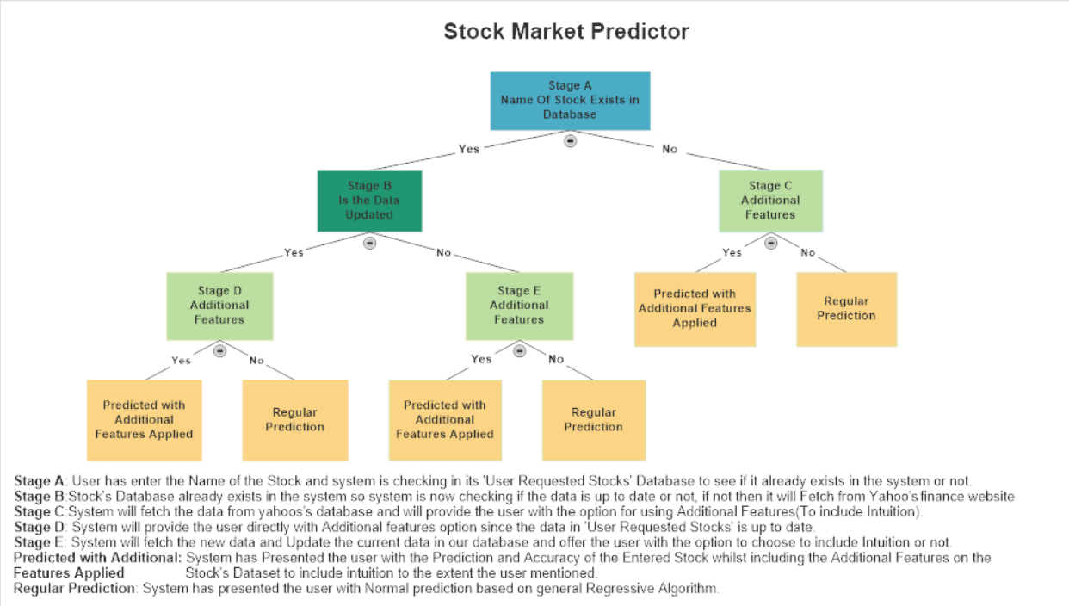
Decision Tree

Slide 12
Data Dictionary

Slide 13
Conclusion
System is able to predict Stock’s Closing prices with the accuracy of 82%+ most of the time, which changes if the user provides a better intuition for the algorithm to work with.
With rough investment the system has proved to be near to accurate for long term calls.

Slide 14
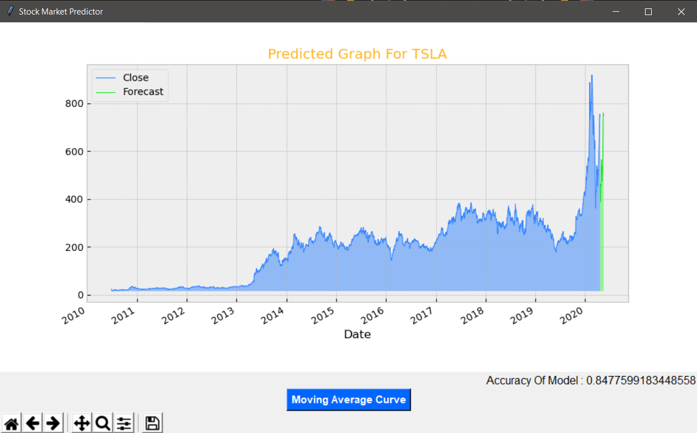
Blue Curve: Old Close Price. Green Curve: Predicted Trajectory for the stock for the coming days

Slide 15
APIs used for Fetching data:
pandas_datareader
nsepy (For Indian Stocks)
yfinance (Yahoo finance database)

Slide 16
THANK YOU

Slide 17
How intuition is included: -
Usually in a lot of machine algorithm which are used for prediction and analysis, we split the dataset into 70% train and 30% test, majority of the dataset is provided to train so as to improve predicting capability of our system while we are in the training phase and after completing this phase we test our system with the 30% reserved test dataset and compare the accuracy of the system.
System provides the user with the option to choose the general direction for prediction i.e. up or down and based on that it will include new data points into the test dataset (21% of prior 70% test dataset) they will either be local maxima’s or minima’s based on the direction, the user will be able to choose from how back it wants to include the datapoints by default it will take 1 month. User can also specify his/her intuitive High, Open and Close. After training the system on the new train dataset it will test it on the reserved segment(2 different Classifiers are used)and predict the accuracy(whichever classifier has the highest accuracy will provide its predicted label), if the user finds better accuracy(with Intuition included) than general predicting algorithm then the user can do whatever he/she wants.

